Slide 1

Algorithms:
Greedy Method
Minimum Spanning Tree

Slide 2
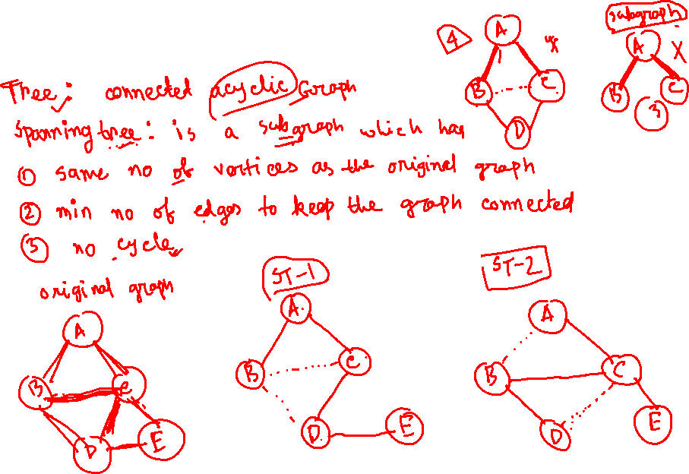

Slide 3
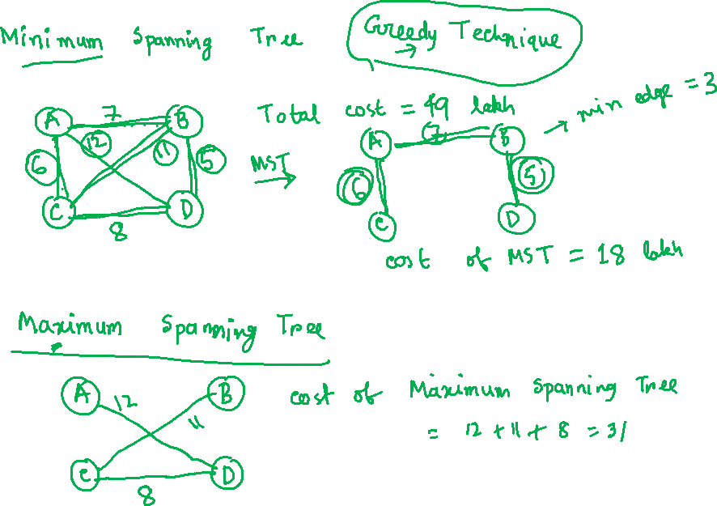

Slide 4
Spanning Tree
A spanning tree is a subset of Graph G, which has all the vertices covered with minimum possible number of edges. Hence, a spanning tree does not have cycles and it cannot be disconnected.. By this definition, we can draw a conclusion that every connected and undirected Graph G has at least one spanning tree.
If there are n vertices in the graph, then each spanning tree has n − 1 edges.

Slide 5
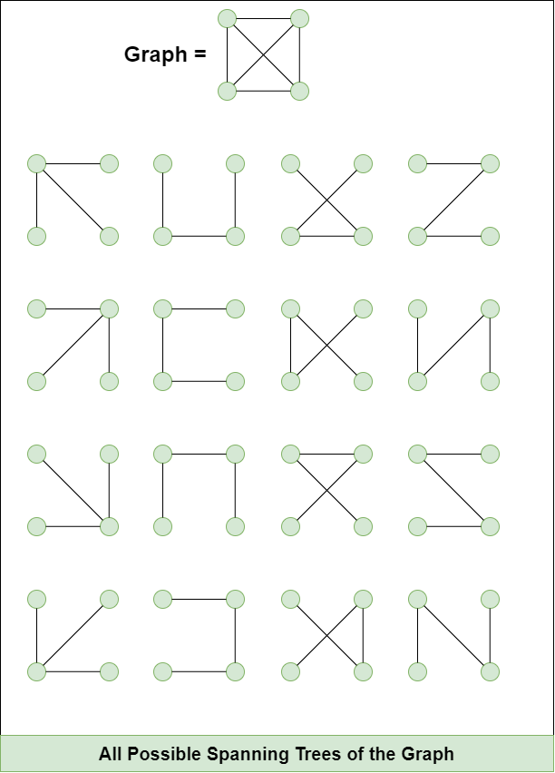

Spanning Tree of a Graph

Slide 6
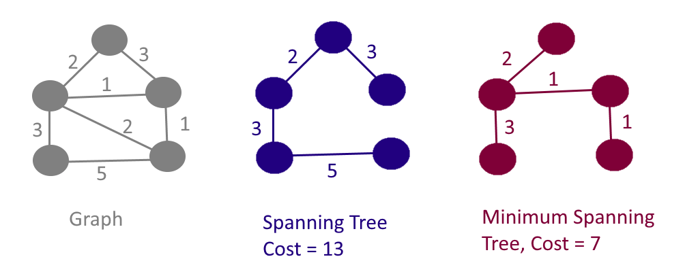
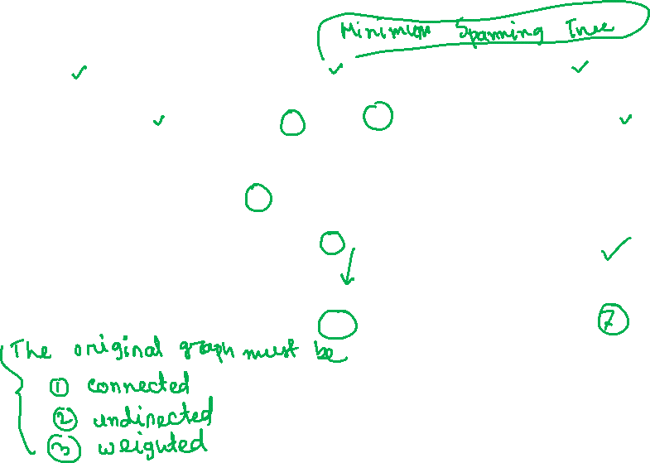
Spanning Tree of a Graph

Slide 7
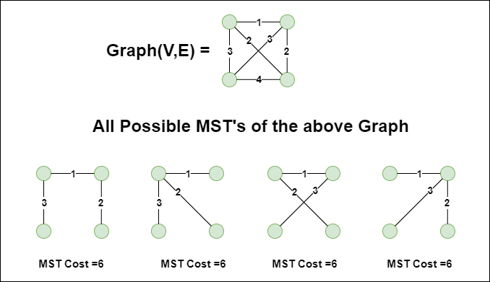
Spanning Tree of a Graph

Slide 8
Minimum Spanning Tree
Problem: given a connected, undirected, weighted graph:
6
4
5
9
14
2
10
15
3
8

Slide 9
Minimum Spanning Tree
Problem: given a connected, undirected, weighted graph, find a spanning tree using edges that minimize the total weight
6
4
5
9
14
2
10
15
3
8

Slide 10
helpful link
https://www.programiz.com/dsa/spanning-tree-and-minimum-spanning-tree
How many edges in a spanning tree?
Is the minimum spanning tree unique?

Slide 11
Minimum Spanning Tree
Which edges form the minimum spanning tree (MST) of the graph as shown below?
A
6
4
H
5
B
9
C
14
2
10
G
E
15
D
3
8
F

Slide 12
Minimum Spanning Tree
Answer:
A
6
4
H
5
B
9
C
14
2
10
G
E
15
D
3
8
F

Slide 13
Minimum Spanning Tree
MSTs satisfy the optimal substructure property: an optimal minimum spanning tree is composed of optimal minimum spanning subtrees
  Let T be an MST of G with an edge (u, v) in the middle
  Removing (u, v) partitions T into two trees T₁ and T₂
  Claim: T₁ is an MST of G₁ = (V₁,E₁), and T₂ is an MST of G₂ = (V₂,E₂) (Do V₁ and V₂ share vertices? Why?)
  Proof: w(T) = w(u,v) + w(T₁) + w(T₂)
  (There can’t be a better tree than T₁ or T₂. Then T would be suboptimal)
6
4
5
9
14
2
10
15
3
8

Slide 14
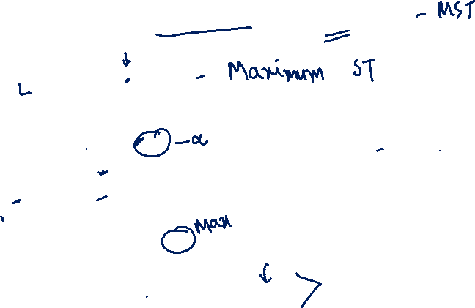
Prim’s Algorithm
MST-Prim(G, w, r)
Q = V[G];
for each u ∈ Q
key[u] = ∞;
key[r] = 0;
p[r] = NULL;
while (Q not empty)
u = ExtractMin(Q);
for each v ∈ Adj[u]
if (v ∈ Q and w(u,v) < key[v])
p[v] = u;
key[v] = w(u,v);

Slide 15
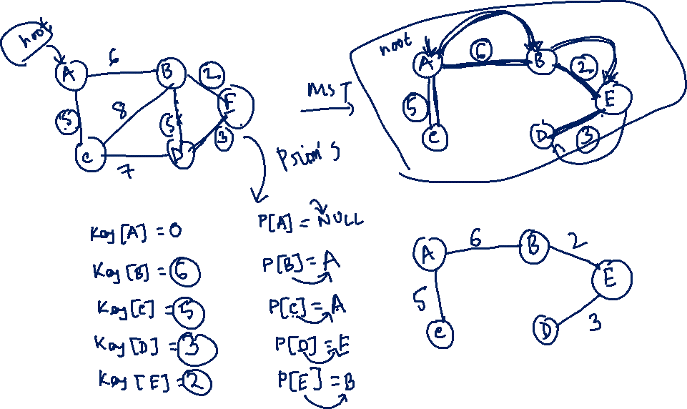

Slide 16
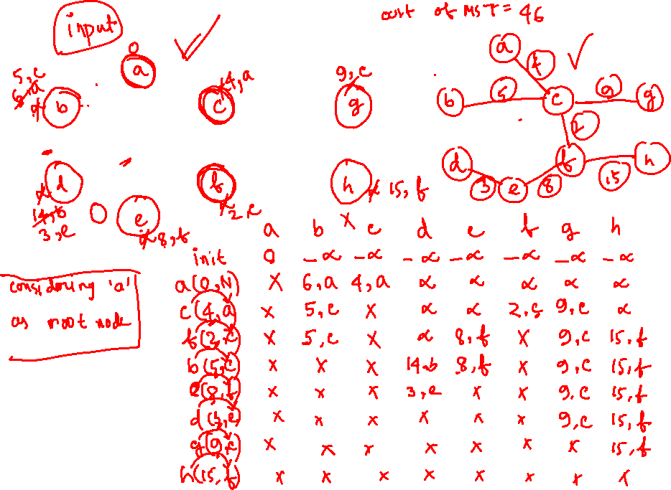
6
4
5
9
14
2
10
15
3
8

Slide 17
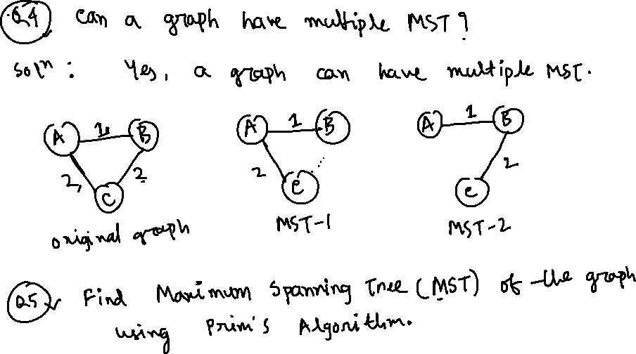

Slide 18
Prim’s Algorithm
6
4
MST-Prim(G, w, r)
Q = V[G];
for each u ∈ Q
key[u] = ∞;
key[r] = 0;
p[r] = NULL;
while (Q not empty)
u = ExtractMin(Q);
for each v ∈ Adj[u]
if (v ∈ Q and w(u,v) < key[v])
p[v] = u;
key[v] = w(u,v);
5
9
14
2
10
15
3
8
Run on example graph

Slide 19
Prim’s Algorithm
MST-Prim(G, w, r)
Q = V[G];
for each u ∈ Q
key[u] = ∞;
key[r] = 0;
p[r] = NULL;
while (Q not empty)
u = ExtractMin(Q);
for each v ∈ Adj[u]
if (v ∈ Q and w(u,v) < key[v])
p[v] = u;
key[v] = w(u,v);
6
∞
4
5
9
∞
∞
∞
14
2
10
15
∞
∞
∞
3
∞
8
Run on example graph

Slide 20
Prim’s Algorithm
MST-Prim(G, w, r)
Q = V[G];
for each u ∈ Q
key[u] = ∞;
key[r] = 0;
p[r] = NULL;
while (Q not empty)
u = ExtractMin(Q);
for each v ∈ Adj[u]
if (v ∈ Q and w(u,v) < key[v])
p[v] = u;
key[v] = w(u,v);
6
∞
4
5
9
∞
∞
∞
14
2
10
15
r
0
∞
∞
3
∞
8
Pick a start vertex r

Slide 21
Prim’s Algorithm
MST-Prim(G, w, r)
Q = V[G];
for each u ∈ Q
key[u] = ∞;
key[r] = 0;
p[r] = NULL;
while (Q not empty)
u = ExtractMin(Q);
for each v ∈ Adj[u]
if (v ∈ Q and w(u,v) < key[v])
p[v] = u;
key[v] = w(u,v);
6
∞
4
5
9
∞
∞
∞
14
2
10
15
u
0
∞
∞
3
∞
8
Red vertices have been removed from Q

Slide 22
Prim’s Algorithm
MST-Prim(G, w, r)
Q = V[G];
for each u ∈ Q
key[u] = ∞;
key[r] = 0;
p[r] = NULL;
while (Q not empty)
u = ExtractMin(Q);
for each v ∈ Adj[u]
if (v ∈ Q and w(u,v) < key[v])
p[v] = u;
key[v] = w(u,v);
6
∞
4
5
9
∞
∞
∞
14
2
10
15
u
0
∞
∞
3
3
8
Red arrows indicate parent pointers

Slide 23
Prim’s Algorithm
MST-Prim(G, w, r)
Q = V[G];
for each u ∈ Q
key[u] = ∞;
key[r] = 0;
p[r] = NULL;
while (Q not empty)
u = ExtractMin(Q);
for each v ∈ Adj[u]
if (v ∈ Q and w(u,v) < key[v])
p[v] = u;
key[v] = w(u,v);
6
∞
4
5
9
14
∞
∞
14
2
10
15
u
0
∞
∞
3
3
8

Slide 24
Prim’s Algorithm
MST-Prim(G, w, r)
Q = V[G];
for each u ∈ Q
key[u] = ∞;
key[r] = 0;
p[r] = NULL;
while (Q not empty)
u = ExtractMin(Q);
for each v ∈ Adj[u]
if (v ∈ Q and w(u,v) < key[v])
p[v] = u;
key[v] = w(u,v);
6
∞
4
5
9
14
∞
∞
14
2
10
15
0
∞
∞
3
3
8
u

Slide 25
Prim’s Algorithm
MST-Prim(G, w, r)
Q = V[G];
for each u ∈ Q
key[u] = ∞;
key[r] = 0;
p[r] = NULL;
while (Q not empty)
u = ExtractMin(Q);
for each v ∈ Adj[u]
if (v ∈ Q and w(u,v) < key[v])
p[v] = u;
key[v] = w(u,v);
6
∞
4
5
9
14
∞
∞
14
2
10
15
0
8
∞
3
3
8
u

Slide 26
Prim’s Algorithm
MST-Prim(G, w, r)
Q = V[G];
for each u ∈ Q
key[u] = ∞;
key[r] = 0;
p[r] = NULL;
while (Q not empty)
u = ExtractMin(Q);
for each v ∈ Adj[u]
if (v ∈ Q and w(u,v) < key[v])
p[v] = u;
key[v] = w(u,v);
6
∞
4
5
9
10
∞
∞
14
2
10
15
0
8
∞
3
3
8
u

Slide 27
Prim’s Algorithm
MST-Prim(G, w, r)
Q = V[G];
for each u ∈ Q
key[u] = ∞;
key[r] = 0;
p[r] = NULL;
while (Q not empty)
u = ExtractMin(Q);
for each v ∈ Adj[u]
if (v ∈ Q and w(u,v) < key[v])
p[v] = u;
key[v] = w(u,v);
6
∞
4
5
9
10
∞
∞
14
2
10
15
0
8
∞
3
3
8
u

Slide 28
Prim’s Algorithm
MST-Prim(G, w, r)
Q = V[G];
for each u ∈ Q
key[u] = ∞;
key[r] = 0;
p[r] = NULL;
while (Q not empty)
u = ExtractMin(Q);
for each v ∈ Adj[u]
if (v ∈ Q and w(u,v) < key[v])
p[v] = u;
key[v] = w(u,v);
6
∞
4
5
9
10
2
∞
14
2
10
15
0
8
∞
3
3
8
u

Slide 29
Prim’s Algorithm
MST-Prim(G, w, r)
Q = V[G];
for each u ∈ Q
key[u] = ∞;
key[r] = 0;
p[r] = NULL;
while (Q not empty)
u = ExtractMin(Q);
for each v ∈ Adj[u]
if (v ∈ Q and w(u,v) < key[v])
p[v] = u;
key[v] = w(u,v);
6
∞
4
5
9
10
2
∞
14
2
10
15
0
8
15
3
3
8
u

Slide 30
Prim’s Algorithm
u
MST-Prim(G, w, r)
Q = V[G];
for each u ∈ Q
key[u] = ∞;
key[r] = 0;
p[r] = NULL;
while (Q not empty)
u = ExtractMin(Q);
for each v ∈ Adj[u]
if (v ∈ Q and w(u,v) < key[v])
p[v] = u;
key[v] = w(u,v);
6
∞
4
5
9
10
2
∞
14
2
10
15
0
8
15
3
3
8

Slide 31
Prim’s Algorithm
u
MST-Prim(G, w, r)
Q = V[G];
for each u ∈ Q
key[u] = ∞;
key[r] = 0;
p[r] = NULL;
while (Q not empty)
u = ExtractMin(Q);
for each v ∈ Adj[u]
if (v ∈ Q and w(u,v) < key[v])
p[v] = u;
key[v] = w(u,v);
6
∞
4
5
9
10
2
9
14
2
10
15
0
8
15
3
3
8

Slide 32
Prim’s Algorithm
u
MST-Prim(G, w, r)
Q = V[G];
for each u ∈ Q
key[u] = ∞;
key[r] = 0;
p[r] = NULL;
while (Q not empty)
u = ExtractMin(Q);
for each v ∈ Adj[u]
if (v ∈ Q and w(u,v) < key[v])
p[v] = u;
key[v] = w(u,v);
6
4
4
5
9
10
2
9
14
2
10
15
0
8
15
3
3
8

Slide 33
Prim’s Algorithm
u
MST-Prim(G, w, r)
Q = V[G];
for each u ∈ Q
key[u] = ∞;
key[r] = 0;
p[r] = NULL;
while (Q not empty)
u = ExtractMin(Q);
for each v ∈ Adj[u]
if (v ∈ Q and w(u,v) < key[v])
p[v] = u;
key[v] = w(u,v);
6
4
4
5
9
5
2
9
14
2
10
15
0
8
15
3
3
8

Slide 34
Prim’s Algorithm
u
MST-Prim(G, w, r)
Q = V[G];
for each u ∈ Q
key[u] = ∞;
key[r] = 0;
p[r] = NULL;
while (Q not empty)
u = ExtractMin(Q);
for each v ∈ Adj[u]
if (v ∈ Q and w(u,v) < key[v])
p[v] = u;
key[v] = w(u,v);
6
4
4
5
9
5
2
9
14
2
10
15
0
8
15
3
3
8

Slide 35
Prim’s Algorithm
u
MST-Prim(G, w, r)
Q = V[G];
for each u ∈ Q
key[u] = ∞;
key[r] = 0;
p[r] = NULL;
while (Q not empty)
u = ExtractMin(Q);
for each v ∈ Adj[u]
if (v ∈ Q and w(u,v) < key[v])
p[v] = u;
key[v] = w(u,v);
6
4
4
5
9
5
2
9
14
2
10
15
0
8
15
3
3
8

Slide 36
Prim’s Algorithm
u
MST-Prim(G, w, r)
Q = V[G];
for each u ∈ Q
key[u] = ∞;
key[r] = 0;
p[r] = NULL;
while (Q not empty)
u = ExtractMin(Q);
for each v ∈ Adj[u]
if (v ∈ Q and w(u,v) < key[v])
p[v] = u;
key[v] = w(u,v);
6
4
4
5
9
5
2
9
14
2
10
15
0
8
15
3
3
8

Slide 37
Prim’s Algorithm
MST-Prim(G, w, r)
Q = V[G];
for each u ∈ Q
key[u] = ∞;
key[r] = 0;
p[r] = NULL;
while (Q not empty)
u = ExtractMin(Q);
for each v ∈ Adj[u]
if (v ∈ Q and w(u,v) < key[v])
p[v] = u;
key[v] = w(u,v);
6
4
4
5
9
5
2
9
14
2
u
10
15
0
8
15
3
3
8

Slide 38
Review: Prim’s Algorithm
MST-Prim(G, w, r)
Q = V[G];
for each u ∈ Q
key[u] = ∞;
key[r] = 0;
p[r] = NULL;
while (Q not empty)
u = ExtractMin(Q);
for each v ∈ Adj[u]
if (v ∈ Q and w(u,v) < key[v])
p[v] = u;
key[v] = w(u,v);
What is the hidden cost in this code?

Slide 39
Review: Prim’s Algorithm
MST-Prim(G, w, r)
Q = V[G];
for each u ∈ Q
key[u] = ∞;
key[r] = 0;
p[r] = NULL;
while (Q not empty)
u = ExtractMin(Q);
for each v ∈ Adj[u]
if (v ∈ Q and w(u,v) < key[v])
p[v] = u;
DecreaseKey(v, w(u,v));

Slide 40
Review: Prim’s Algorithm
MST-Prim(G, w, r)
Q = V[G];
for each u ∈ Q
key[u] = ∞;
key[r] = 0;
p[r] = NULL;
while (Q not empty)
u = ExtractMin(Q);
for each v ∈ Adj[u]
if (v ∈ Q and w(u,v) < key[v])
p[v] = u;
DecreaseKey(v, w(u,v));
How often is ExtractMin() called?
How often is DecreaseKey() called?

Slide 41
Review: Prim’s Algorithm
MST-Prim(G, w, r)
Q = V[G];
for each u ∈ Q
key[u] = ∞;
key[r] = 0;
p[r] = NULL;
while (Q not empty)
u = ExtractMin(Q);
for each v ∈ Adj[u]
if (v ∈ Q and w(u,v) < key[v])
p[v] = u;
key[v] = w(u,v);
What will be the running time?
A: Depends on queue
binary heap: O(E lg V)
Fibonacci heap: O(V lg V + E)

Slide 42
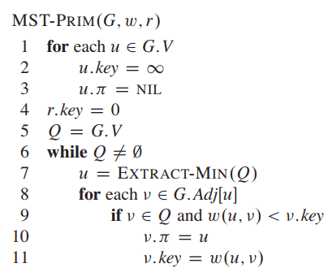
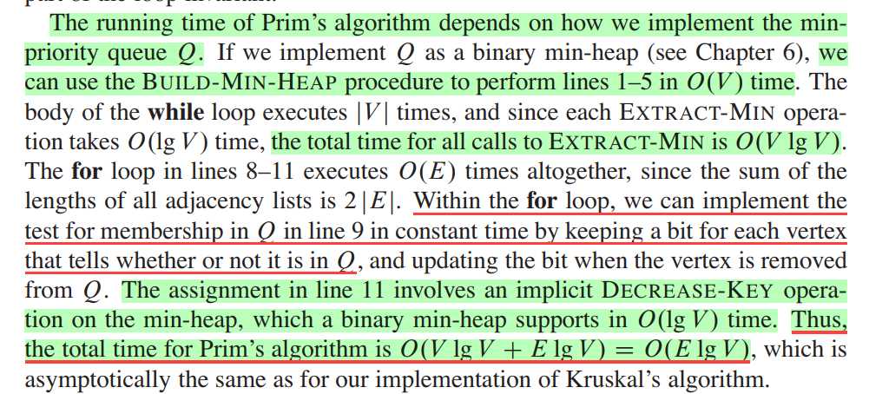
Cormen 23

Slide 43
Prim's algorithm is very similar to Kruskal's: whereas Kruskal's "grows" a forest of trees, Prim's algorithm grows a single tree until it becomes the minimum spanning tree. Both algorithms use the greedy approach - they add the cheapest edge that will not cause a cycle. But rather than choosing the cheapest edge that will connect any pair of trees together, Prim's algorithm only adds edges that join nodes to the existing tree. (In this respect, Prim's algorithm is very similar to Dijkstra's algorithm for finding shortest paths.)
https://www.cs.auckland.ac.nz/software/AlgAnim/prim.html

Slide 44
Disjoint-Set Union Problem
Want a data structure to support disjoint sets
  Collection of disjoint sets S = U_{i} {S_{i}}, S_{i} ∩ S_{j} = ∅
Need to support following operations:
  MakeSet(x): S = S U {{x}}
  Union(S_{i}, S_{j}): S = S - {S_{i}, S_{j}} U {S_{i} U S_{j}}
  FindSet(x): return S_{i} ∈ S such that x ∈ S_{i}
Before discussing implementation details, we look at example application: MSTs

Slide 45
Kruskal’s Algorithm
Kruskal()
{
T = ∅;
for each v ∈ V
MakeSet(v);
sort E into nondecreasing order by weight w
for each (u,v) ∈ E (in sorted order)
if FindSet(u) ≠ FindSet(v)
T = T U {{u,v}};
Union(u,v);
}

Slide 46
Kruskal’s Algorithm
2
19
Kruskal()
{
T = ∅;
for each v ∈ V
MakeSet(v);
sort E into nondecreasing order by weight w
for each (u,v) ∈ E (in sorted order)
if FindSet(u) ≠ FindSet(v)
T = T U {{u,v}};
Union(u,v);
}
9
14
17
8
25
5
21
13
1

Slide 47
Kruskal’s Algorithm
2
19
Kruskal()
{
T = ∅;
for each v ∈ V
MakeSet(v);
sort E into nondecreasing order by weight w
for each (u,v) ∈ E (in sorted order)
if FindSet(u) ≠ FindSet(v)
T = T U {{u,v}};
Union(u,v);
}
9
14
17
8
25
5
21
13
1

Slide 48
Kruskal’s Algorithm
2
19
Kruskal()
{
T = ∅;
for each v ∈ V
MakeSet(v);
sort E into nondecreasing order by weight w
for each (u,v) ∈ E (in sorted order)
if FindSet(u) ≠ FindSet(v)
T = T U {{u,v}};
Union(u,v);
}
9
14
17
8
25
5
21
13
1

Slide 49
Kruskal’s Algorithm
2
19
Kruskal()
{
T = ∅;
for each v ∈ V
MakeSet(v);
sort E into nondecreasing order by weight w
for each (u,v) ∈ E (in sorted order)
if FindSet(u) ≠ FindSet(v)
T = T U {{u,v}};
Union(u,v);
}
9
14
17
8
25
5
21
13
1?

Slide 50
Kruskal’s Algorithm
2
19
Kruskal()
{
T = ∅;
for each v ∈ V
MakeSet(v);
sort E into nondecreasing order by weight w
for each (u,v) ∈ E (in sorted order)
if FindSet(u) ≠ FindSet(v)
T = T U {{u,v}};
Union(u,v);
}
9
14
17
8
25
5
21
13
1

Slide 51
Kruskal’s Algorithm
2?
19
Kruskal()
{
T = ∅;
for each v ∈ V
MakeSet(v);
sort E into nondecreasing order by weight w
for each (u,v) ∈ E (in sorted order)
if FindSet(u) ≠ FindSet(v)
T = T U {{u,v}};
Union(u,v);
}
9
14
17
8
25
5
21
13
1

Slide 52
Kruskal’s Algorithm
2
19
Kruskal()
{
T = ∅;
for each v ∈ V
MakeSet(v);
sort E into nondecreasing order by weight w
for each (u,v) ∈ E (in sorted order)
if FindSet(u) ≠ FindSet(v)
T = T U {{u,v}};
Union(u,v);
}
9
14
17
8
25
5
21
13
1

Slide 53
Kruskal’s Algorithm
2
19
Kruskal()
{
T = ∅;
for each v ∈ V
MakeSet(v);
sort E into nondecreasing order by weight w
for each (u,v) ∈ E (in sorted order)
if FindSet(u) ≠ FindSet(v)
T = T U {{u,v}};
Union(u,v);
}
9
14
17
8
25
5?
21
13
1

Slide 54
Kruskal’s Algorithm
2
19
Kruskal()
{
T = ∅;
for each v ∈ V
MakeSet(v);
sort E into nondecreasing order by weight w
for each (u,v) ∈ E (in sorted order)
if FindSet(u) ≠ FindSet(v)
T = T U {{u,v}};
Union(u,v);
}
9
14
17
8
25
5
21
13
1

Slide 55
Kruskal’s Algorithm
2
19
Kruskal()
{
T = ∅;
for each v ∈ V
MakeSet(v);
sort E into nondecreasing order by weight w
for each (u,v) ∈ E (in sorted order)
if FindSet(u) ≠ FindSet(v)
T = T U {{u,v}};
Union(u,v);
}
9
14
17
8?
25
5
21
13
1

Slide 56
Kruskal’s Algorithm
2
19
Kruskal()
{
T = ∅;
for each v ∈ V
MakeSet(v);
sort E into nondecreasing order by weight w
for each (u,v) ∈ E (in sorted order)
if FindSet(u) ≠ FindSet(v)
T = T U {{u,v}};
Union(u,v);
}
9
14
17
8
25
5
21
13
1

Slide 57
Kruskal’s Algorithm
2
19
Kruskal()
{
T = ∅;
for each v ∈ V
MakeSet(v);
sort E into nondecreasing order by weight w
for each (u,v) ∈ E (in sorted order)
if FindSet(u) ≠ FindSet(v)
T = T U {{u,v}};
Union(u,v);
}
9?
14
17
8
25
5
21
13
1

Slide 58
Kruskal’s Algorithm
2
19
Kruskal()
{
T = ∅;
for each v ∈ V
MakeSet(v);
sort E into nondecreasing order by weight w
for each (u,v) ∈ E (in sorted order)
if FindSet(u) ≠ FindSet(v)
T = T U {{u,v}};
Union(u,v);
}
9
14
17
8
25
5
21
13
1

Slide 59
Kruskal’s Algorithm
2
19
Kruskal()
{
T = ∅;
for each v ∈ V
MakeSet(v);
sort E into nondecreasing order by weight w
for each (u,v) ∈ E (in sorted order)
if FindSet(u) ≠ FindSet(v)
T = T U {{u,v}};
Union(u,v);
}
9
14
17
8
25
5
21
13?
1

Slide 60
Kruskal’s Algorithm
2
19
Kruskal()
{
T = ∅;
for each v ∈ V
MakeSet(v);
sort E into nondecreasing order by weight w
for each (u,v) ∈ E (in sorted order)
if FindSet(u) ≠ FindSet(v)
T = T U {{u,v}};
Union(u,v);
}
9
14
17
8
25
5
21
13
1

Slide 61
Kruskal’s Algorithm
2
19
Kruskal()
{
T = ∅;
for each v ∈ V
MakeSet(v);
sort E into nondecreasing order by weight w
for each (u,v) ∈ E (in sorted order)
if FindSet(u) ≠ FindSet(v)
T = T U {{u,v}};
Union(u,v);
}
9
14?
17
8
25
5
21
13
1

Slide 62
Kruskal’s Algorithm
2
19
Kruskal()
{
T = ∅;
for each v ∈ V
MakeSet(v);
sort E into nondecreasing order by weight w
for each (u,v) ∈ E (in sorted order)
if FindSet(u) ≠ FindSet(v)
T = T U {{u,v}};
Union(u,v);
}
9
14
17
8
25
5
21
13
1

Slide 63
Kruskal’s Algorithm
2
19
Kruskal()
{
T = ∅;
for each v ∈ V
MakeSet(v);
sort E into nondecreasing order by weight w
for each (u,v) ∈ E (in sorted order)
if FindSet(u) ≠ FindSet(v)
T = T U {{u,v}};
Union(u,v);
}
9
14
17?
8
25
5
21
13
1

Slide 64
Kruskal’s Algorithm
2
19?
Kruskal()
{
T = ∅;
for each v ∈ V
MakeSet(v);
sort E into nondecreasing order by weight w
for each (u,v) ∈ E (in sorted order)
if FindSet(u) ≠ FindSet(v)
T = T U {{u,v}};
Union(u,v);
}
9
14
17
8
25
5
21
13
1

Slide 65
Kruskal’s Algorithm
2
19
Kruskal()
{
T = ∅;
for each v ∈ V
MakeSet(v);
sort E into nondecreasing order by weight w
for each (u,v) ∈ E (in sorted order)
if FindSet(u) ≠ FindSet(v)
T = T U {{u,v}};
Union(u,v);
}
9
14
17
8
25
5
21?
13
1

Slide 66
Kruskal’s Algorithm
2
19
Kruskal()
{
T = ∅;
for each v ∈ V
MakeSet(v);
sort E into nondecreasing order by weight w
for each (u,v) ∈ E (in sorted order)
if FindSet(u) ≠ FindSet(v)
T = T U {{u,v}};
Union(u,v);
}
9
14
17
8
25?
5
21
13
1

Slide 67
Kruskal’s Algorithm
2
19
Kruskal()
{
T = ∅;
for each v ∈ V
MakeSet(v);
sort E into nondecreasing order by weight w
for each (u,v) ∈ E (in sorted order)
if FindSet(u) ≠ FindSet(v)
T = T U {{u,v}};
Union(u,v);
}
9
14
17
8
25
5
21
13
1

Slide 68
Kruskal’s Algorithm
2
19
Kruskal()
{
T = ∅;
for each v ∈ V
MakeSet(v);
sort E into nondecreasing order by weight w
for each (u,v) ∈ E (in sorted order)
if FindSet(u) ≠ FindSet(v)
T = T U {{u,v}};
Union(u,v);
}
9
14
17
8
25
5
21
13
1

Slide 69
Kruskal’s Algorithm: Running Time
What will affect the running time?
Kruskal()
{
T = ∅;
for each v ∈ V
MakeSet(v);
sort E by increasing edge weight w
for each (u,v) ∈ E (in sorted order)
if FindSet(u) ≠ FindSet(v)
T = T U {{u,v}};
Union(u,v);
}

Slide 70
Kruskal’s Algorithm: Running Time
What will affect the running time?
1 Sort
O(V) MakeSet() calls
O(E) FindSet() calls
O(V) Union() calls
(Exactly how many Union()s?)
Kruskal()
{
T = ∅;
for each v ∈ V
MakeSet(v);
sort E by increasing edge weight w
for each (u,v) ∈ E (in sorted order)
if FindSet(u) ≠ FindSet(v)
T = T U {{u,v}};
Union(u,v);
}

Slide 71
Kruskal’s Algorithm: Running Time
To summarize:
  Sort edges: O(E lg E)
  O(V) MakeSet()’s
  O(E) FindSet()’s
  O(V) Union()’s
Upshot:
  Best disjoint-set operation algorithm makes above three operations to take O(E lg E) time.
  Thus overall time is O(E lg E) = O(E lg V), since |E| < |V|²

Slide 72
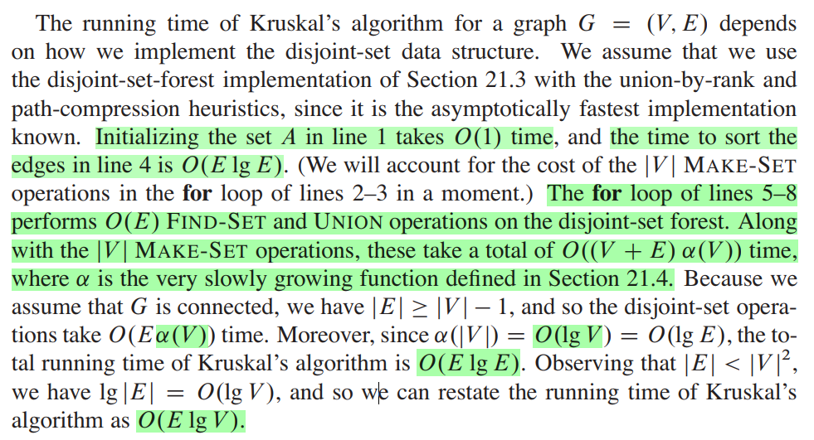
Kruskal’s Algorithm: Running Time
To summarize:
  Sort edges: O(E lg E)
  O(V) MakeSet()’s
  O(E) FindSet()’s
  O(V) Union()’s
Cormen 23.2

Slide 73
How can you find the second best minimum spanning tree?
https://cp-algorithms.com/graph/second_best_mst.html
Draw a minimum spanning tree of the given graph G such that the minimum spanning tree always consists the edges with weights x and z.
Assign weights to each of the edges such that the MST of this graph consists exactly of the edges …
Kruskal’s algorithm may provide different Minimum Spanning Trees (MST) based on how it sorts the edge-list of the graph. Provide an example of a graph where the Kruskal’s algorithm will return two different MSTs on two different runs of the algorithm, based on the edge-list being sorted differently.
Analyze the running time of the algorithm.

